Slide 1
Contextual Challenge 2020-2021
By Kahngjoon Koh

Slide 2
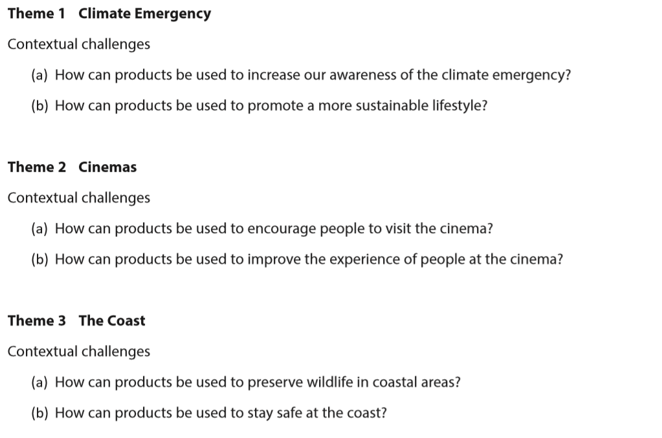
Choosing the Contextual Challenge

Slide 3
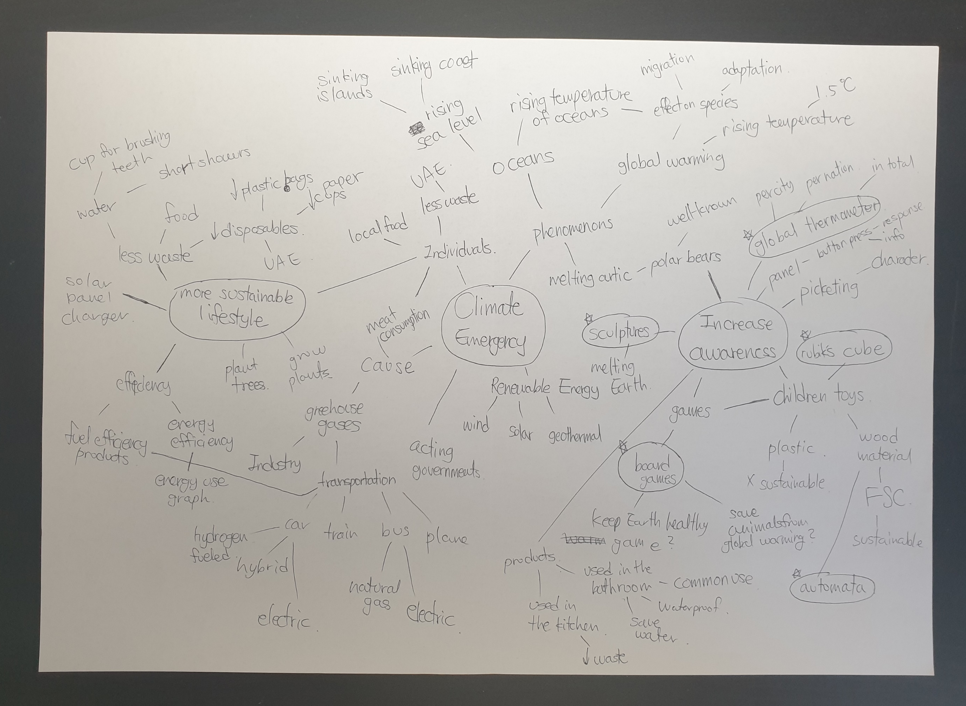
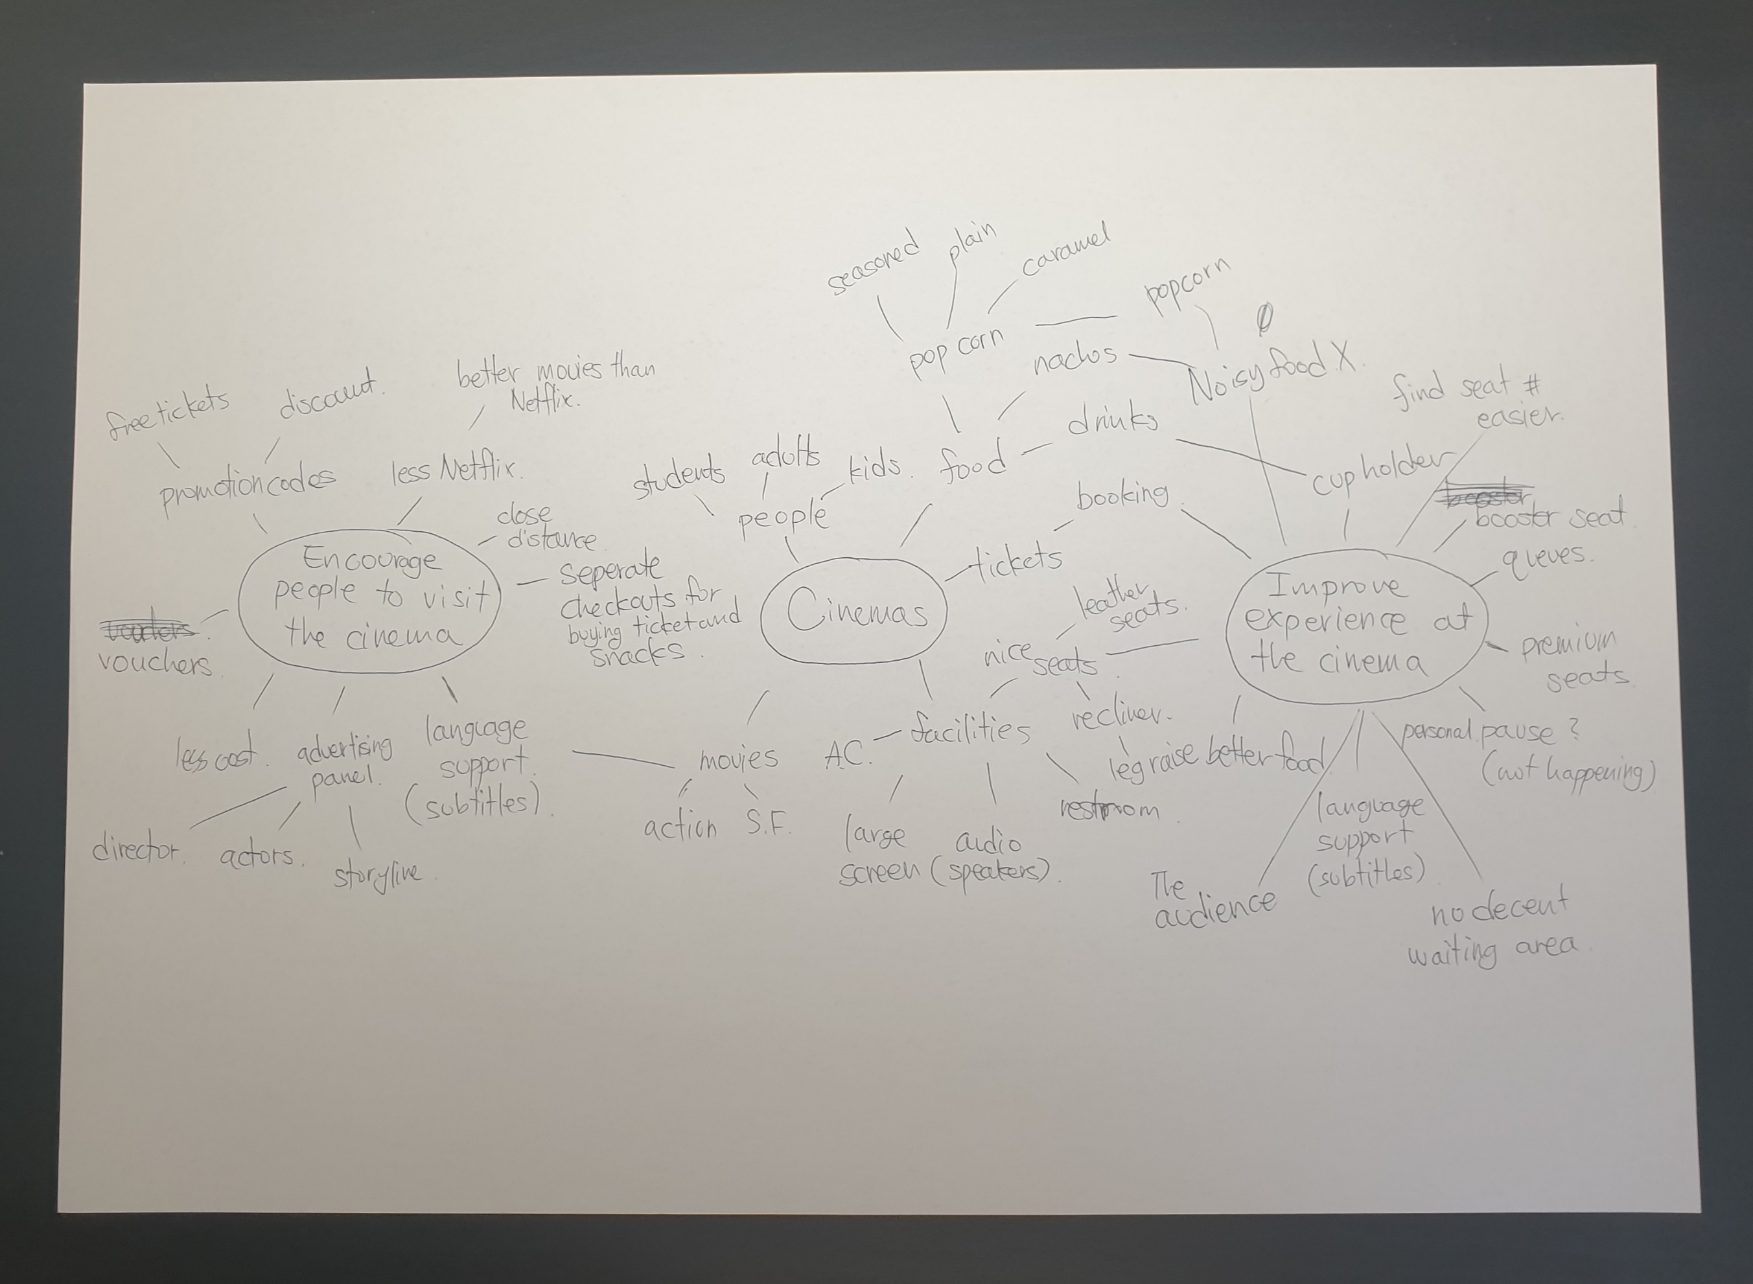
Choosing the Contextual Challenge
To choose the most suitable option I have considered every theme and question. Hence, I have created a mind map for each theme to portray my general knowledge and the possible ideas related to it. As a result, I could overview the choices and make the most reasonable decision.
Theme 1: Climate Emergency
This was the most familiar theme to me. I was able to produce the largest and informative mind map.
How can products be used to increase our awareness of climate emergency?
I loved the idea at first. However, after some time of thinking I thought that the concept of “measuring” awareness was to vague. I could do surveys but I thought just knowing the concept(knows but does not apply) and being more aware(continuously ) was different and surveys, nor any method could measure what is in the conscious state of one’d mind. Therefore, this option was eliminated.
How can products be used to promote a more sustainable lifestyle?
This contextual challenge was interesting as the place I live in was the UAE. I have not lived here long but it was enough for me to realize the overuse of disposables and lack of sustainable lifestyle: there is no recycling in my compound. This option was related to me as well. Therefore, I was more engaged into this. Since the UAE residents did have awareness of at least some climate emergency(they started to implement environment policies), I found it to be a perfect situation to make a product that promoted sustainable lifestyles.
Theme 2: The Cinema
Cinemas sounded very familiar, but when I started brainstorming about it, it turned out to be not.
How can products be used to encourage people to visit the cinema?
As I do not go to the cinema often, I questioned myself why would I not go to cinemas. I figured there was no actual need to go to the cinema except for watching hit-movies or just released movies. In fact, many movies are available to be watched in homes which are more convenient. What I thought was the most effective method in encouraging people to visit the cinema was to advertise the movie. And that quite limits my range of products. As a result, I did not choose this contextual challenge.
How can products be used to improve the experience of people at the cinema?
I made a brief research of what people though about the experiences at the cinema. The research told the problem was diverse. Starting from bringing crunchy food in the cinema, not turning their mobile devices off and talking noises that could be heard. The problems were mostly because of the audience’s behaviour and not really much to do with the cinema itself. Therefore, I concluded this contextual challenge to be inadequate for me.

Slide 4
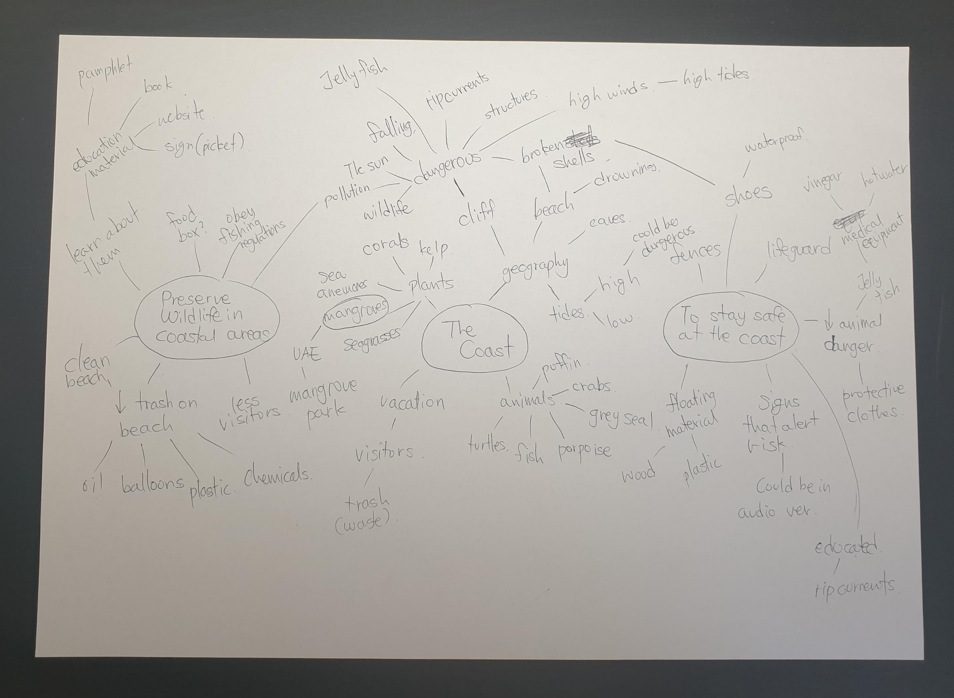
Choosing the Contextual Challenge
Theme 3: The Coast
The theme was a challenge as I was not familiar with the coast. Therefore, I had to research information to get a decent overview of the theme.
How can products be used to preserve wildlife in coastal areas?
It was fortunate to live in the UAE and have access to many coastal areas including The Mangrove, Corniche, and Al Bateen beach which is close by. This physical proximity would definitely help me out in researching the wildlife and coming up with initial ideas.
How can products be used to stay safe at the coast?
I have been to Al Bateen Beach and personally the sand had many broken sea shells that may cause a cut. It was appealing as approach “staying safe at the coast” could be done both physically(fences) and mentally(putting up warning signs). One thing that was confusing about the challenge was that there could be two possible types of “coasts”. The first one would be the beach, the second would be the rocky cliff near the ocean. Each one has its own dangers which made me confusing. Furthermore, UAE does not have the latter. As a result, I have excluded the option.
My Choice:
How can products be used to promote a more sustainable lifestyle?
I thought familiarity was important for the thinking up with initial ideas and adaptation of the products I will be making. Similarly, I valued my personal motivation. Furthermore, the UAE government is starting to consider climate emergency which means I can benefit from it in someway.(more interest in my product, more people who heard of the term, better feedback that gives more possibility to improve, etc) Also, the broadness of the topic gives me more range of products that I can make. Therefore, I have chosen this contextual challenge.

Slide 5
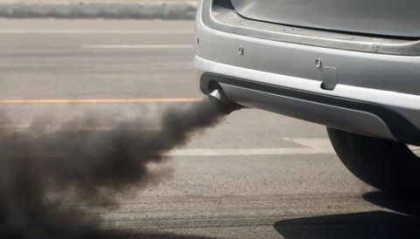
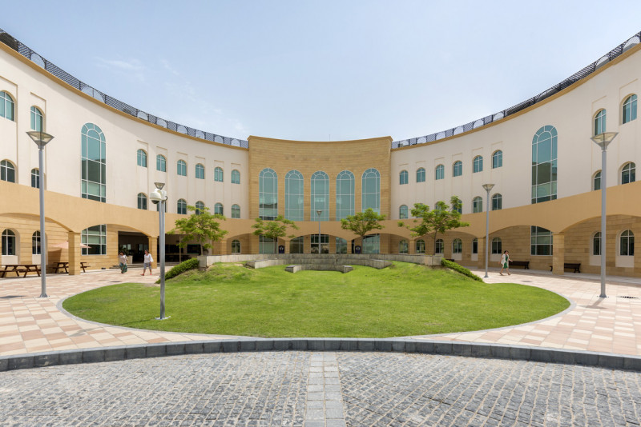
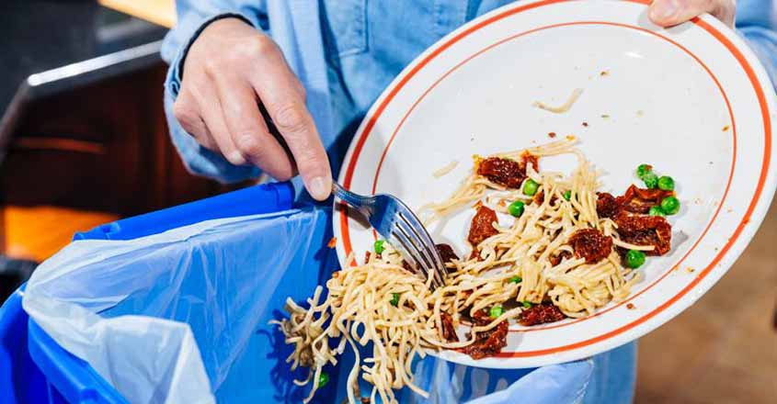
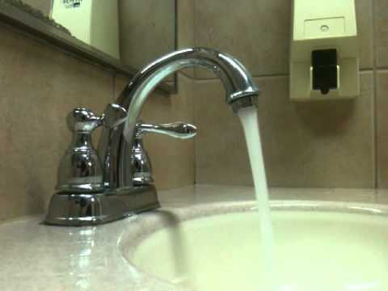
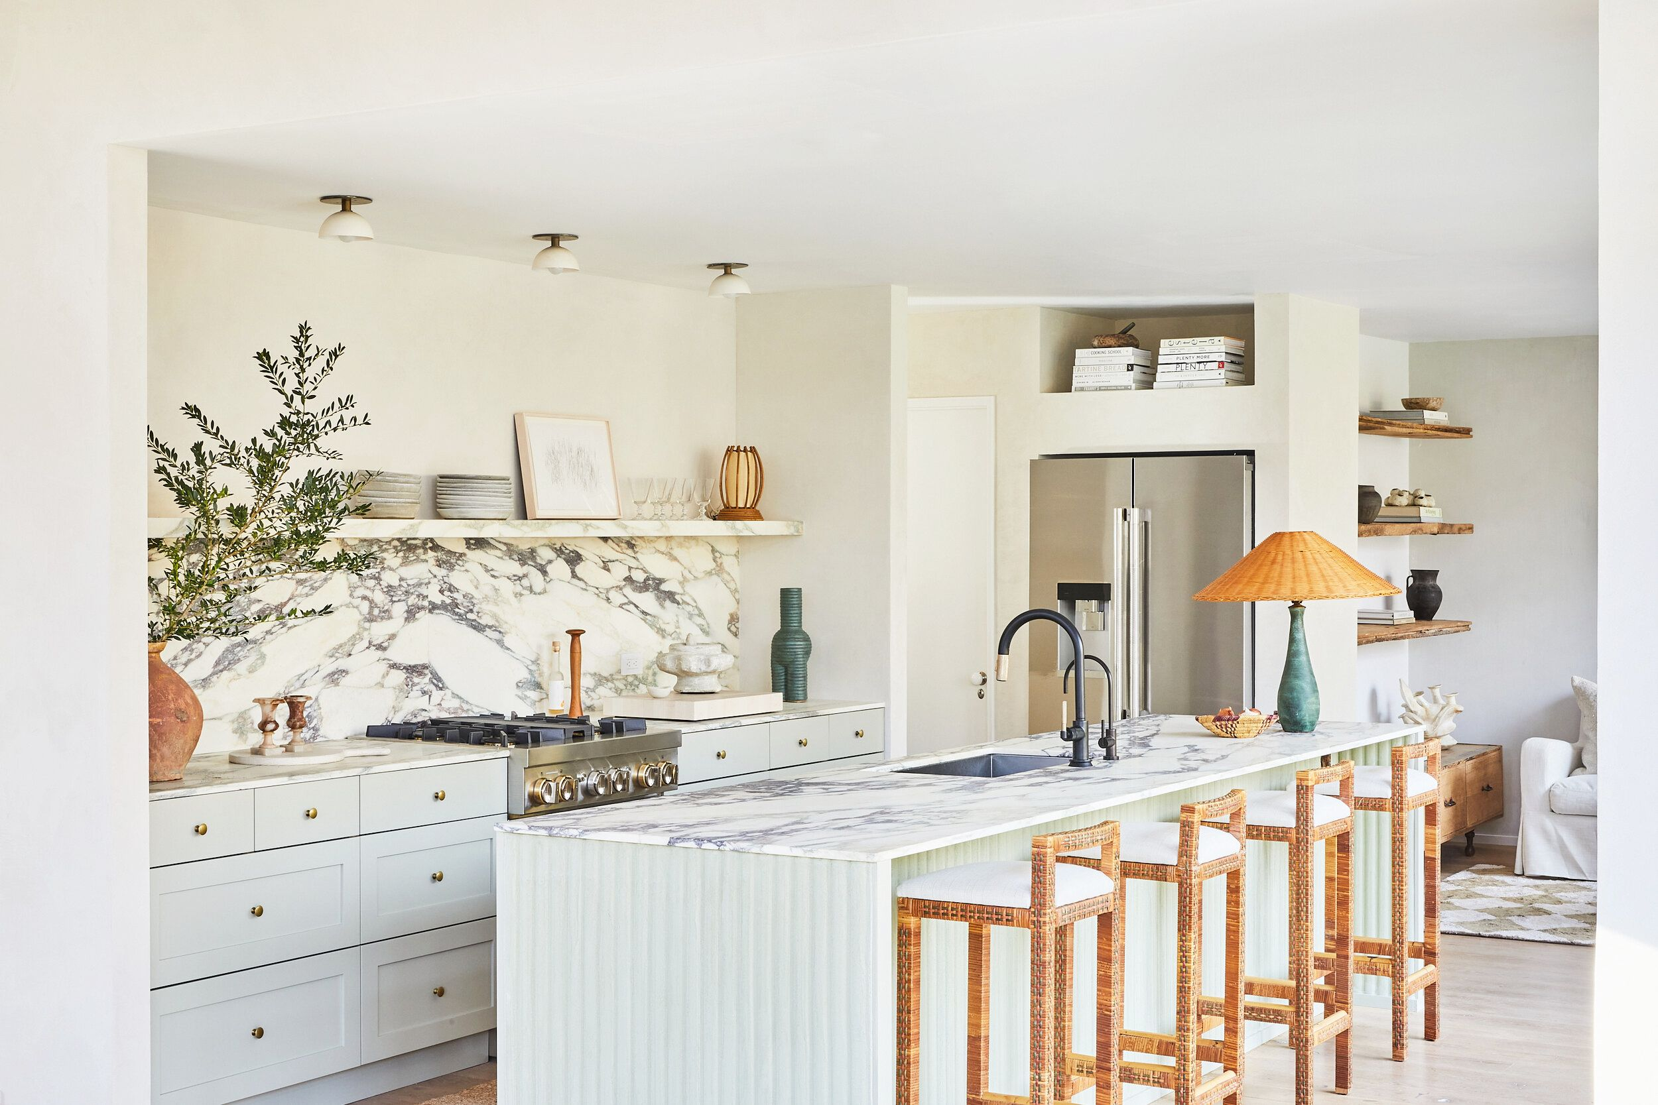
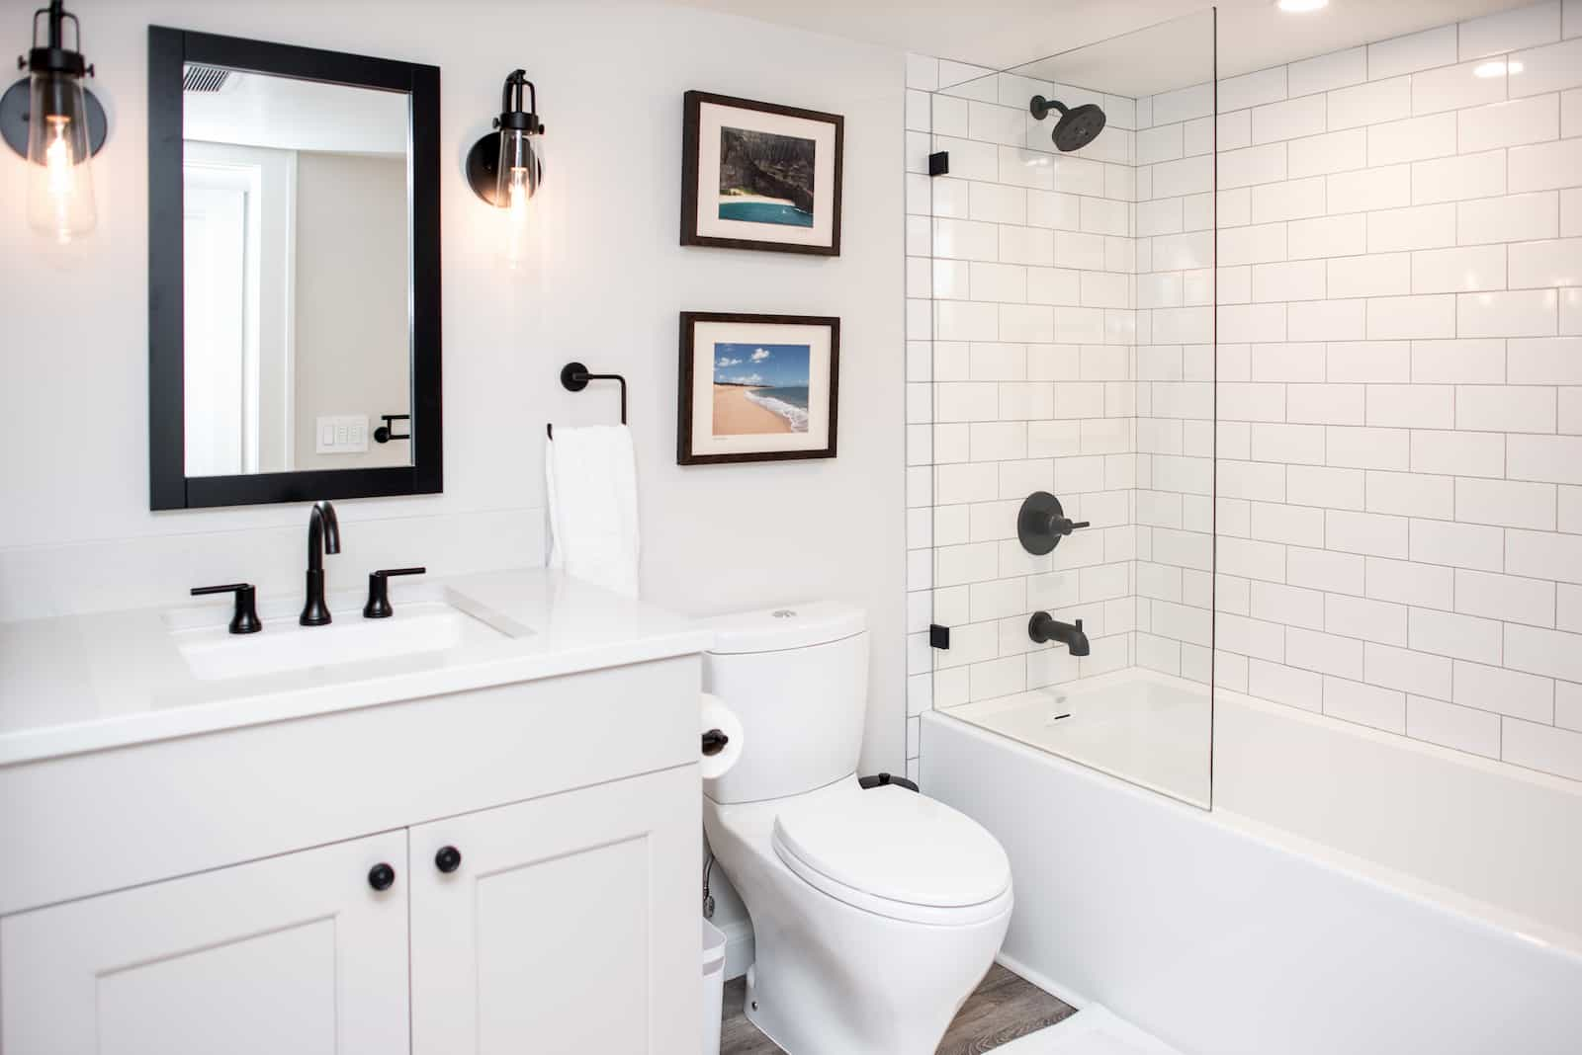

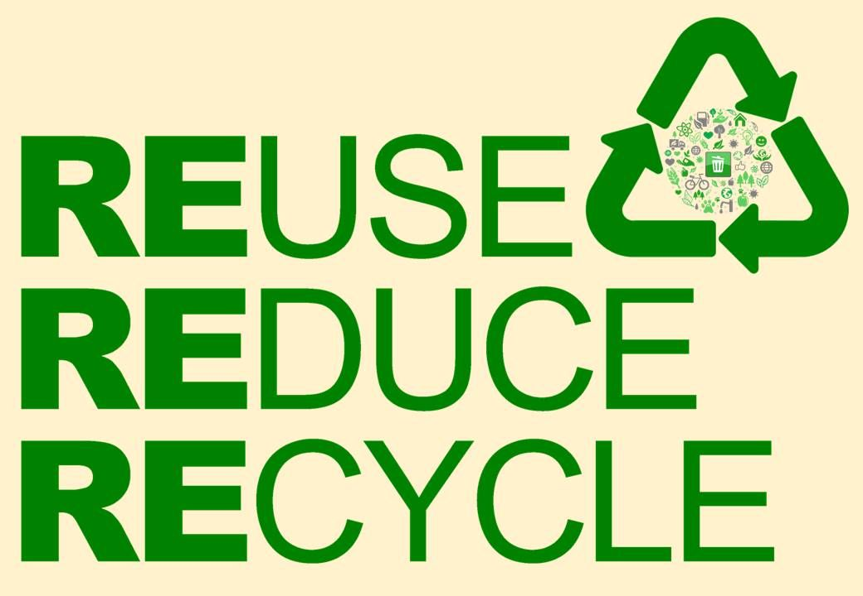
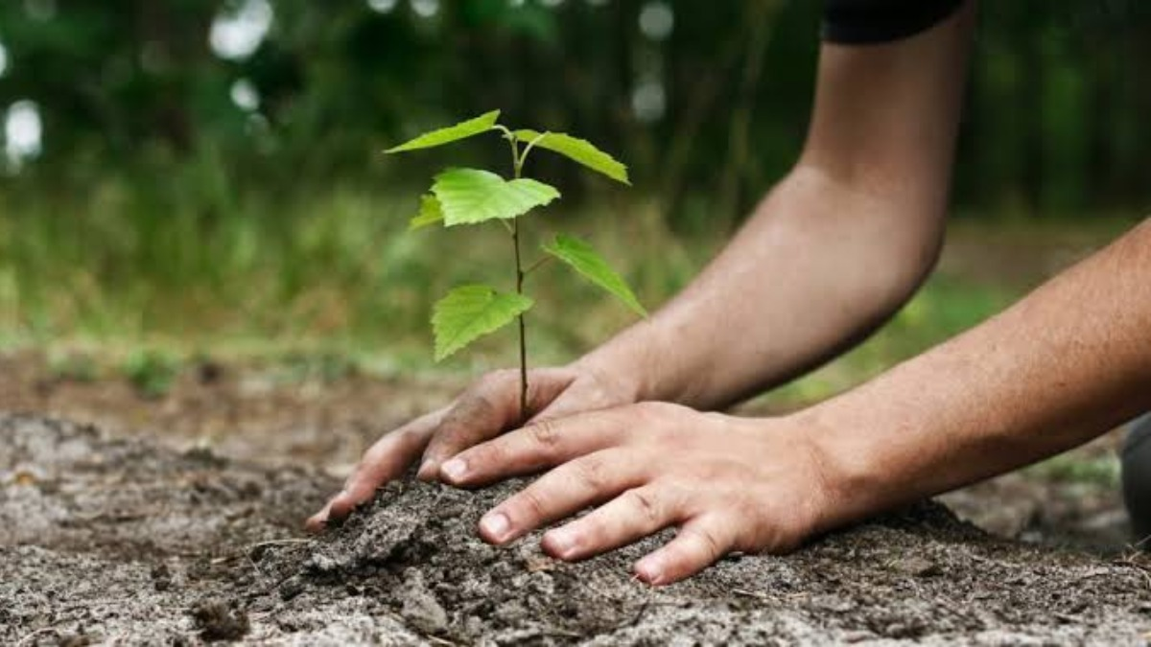
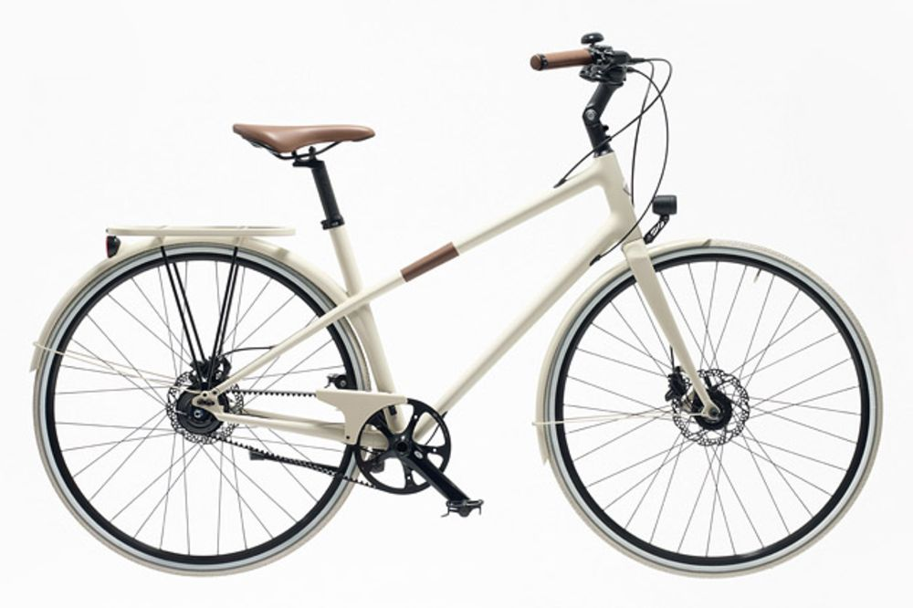
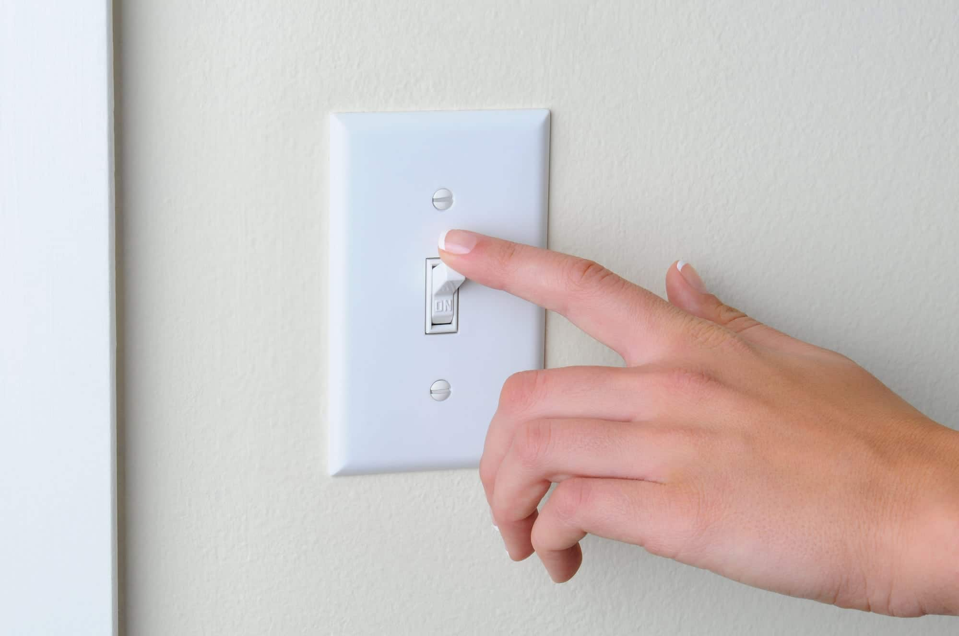
Overview of the Contextual Challenge
Problems
Sustainable Lifestyle
Where?
Solutions

Slide 6
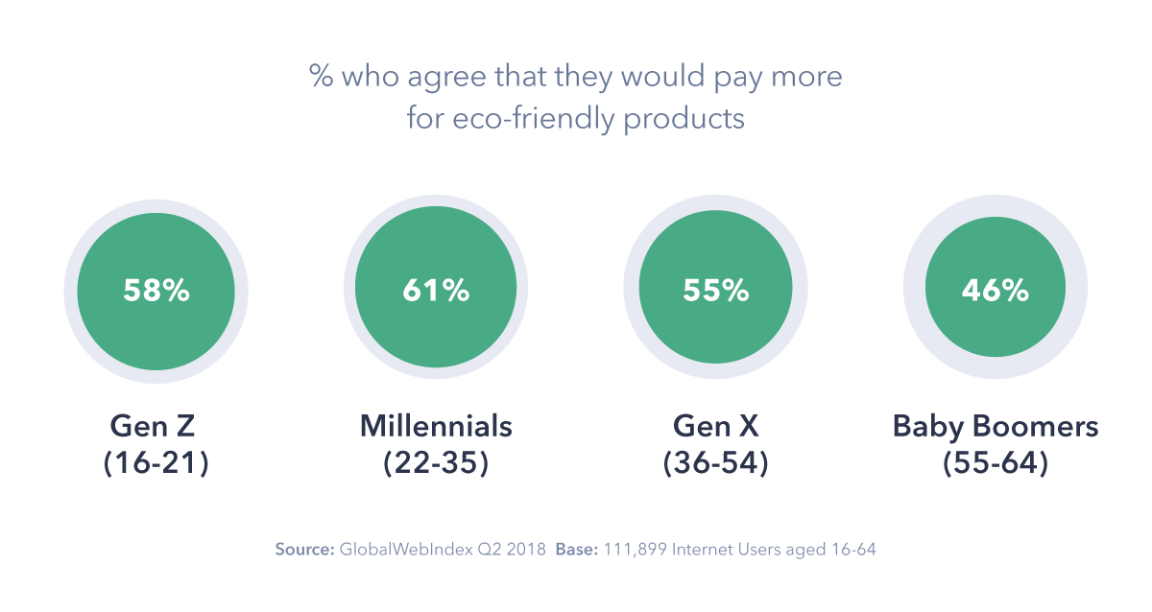
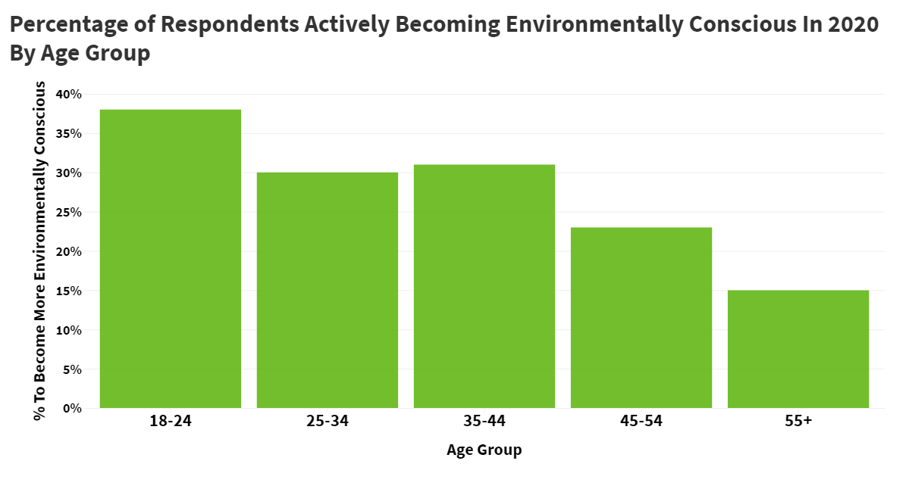
Introduction
How can products be used to promote a more sustainable lifestyle?
Identify the needs for the end user:
In this first section, I will look through the problems with the current lifestyles of people and how
The users could be potentially anyone. So I ask the question “who should the product target?” To answer this there is a need to divide the users into user groups and research each of them. Prior to research, I have divided the user groups arbitrarily as shown:
0-6
7-11
12-18
19-24
25-54
55+
After researching I found out that the age groups of 55+ are less likely to make environmentally-friendly decisions. Therefore, I have to
It is said that
I have not considered gender as to be a significant aspect at first, however, after visiting https://www.iucn.org/resources/issues-briefs/gender-and-climate-change my thoughts on this changed. The website said that “Women have proven to be leading the way towards more equitable and sustainable solutions to climate change” However, I could not find any evidence that supported the conclusion. Therefore, I decided to have a survey about the people. The survey would look as follows:
1. What is your gender?
2. Check all that apply (electricity):
I turn of the lights when I do not use them
I buy energy-efficient products
I shut off my computer when I do not use them
I use natural lights as much as I can instead of artificial lights
I unplug my phone charger when I do not use them
I keep my AC temperature at 26C or higher
3. Check all that apply (water):
I use a reusable water bottle or a mug
I take showers less than 10 minutes
I turn off the tap when brushing my teeth or shaving
I do not let the hose running when washing the car
4. Check all that apply (Food):
I eat all(or most) of the food on my dish
I buy (or eat) local foods or organic foods
I do not eat a lot of meat
5. Check all that apply (additional):
I avoid using plastic bags
I avoid using disposable items(plastic cups, etc)
6. Is there anything you do that is considered environmentally friendly?
It is based on the US department of energy checklist for energy sustainability and other resource.

Slide 7
Introduction
How can products be used to promote a more sustainable lifestyle?
Needs for the end user:
The users (or audience) could be potentially anyone. So I ask the question “who should the product target?” To answer this there is a need to divide the users into user groups and research each of them. Prior to research, I have divided the user groups arbitrarily as shown:
0-6
7-11
12-18
19-24
25-54
55+
After researching I found out that the age groups of 55+ are less likely to make environmentally-friendly decisions. Therefore, I have to
It is said that
I have not considered gender as to be a significant aspect at first, however, after visiting https://www.iucn.org/resources/issues-briefs/gender-and-climate-change my thoughts on this changed. The website said that “Women have proven to be leading the way towards more equitable and sustainable solutions to climate change” However, I could not find any evidence that supported the conclusion. Therefore, I decided to have a survey about the people. The survey would look as follows:
1. What is your gender?
2. Check all that apply (electricity):
I turn of the lights when I do not use them
I buy energy-efficient products
I shut off my computer when I do not use them
I use natural lights as much as I can instead of artificial lights
I unplug my phone charger when I do not use them
I keep my AC temperature at 26C or higher
3. Check all that apply (water):
I use a reusable water bottle or a mug
I take showers less than 10 minutes
I turn off the tap when brushing my teeth or shaving
I do not let the hose running when washing the car
4. Check all that apply (Food):
I eat all(or most) of the food on my dish
I buy (or eat) local foods or organic foods
I do not eat a lot of meat
5. Check all that apply (additional):
I avoid using plastic bags
I avoid using disposable items(plastic cups, etc)
6. Is there anything you do that is considered environmentally friendly?
It is based on the US department of energy checklist for energy sustainability and other resource.

Slide 8
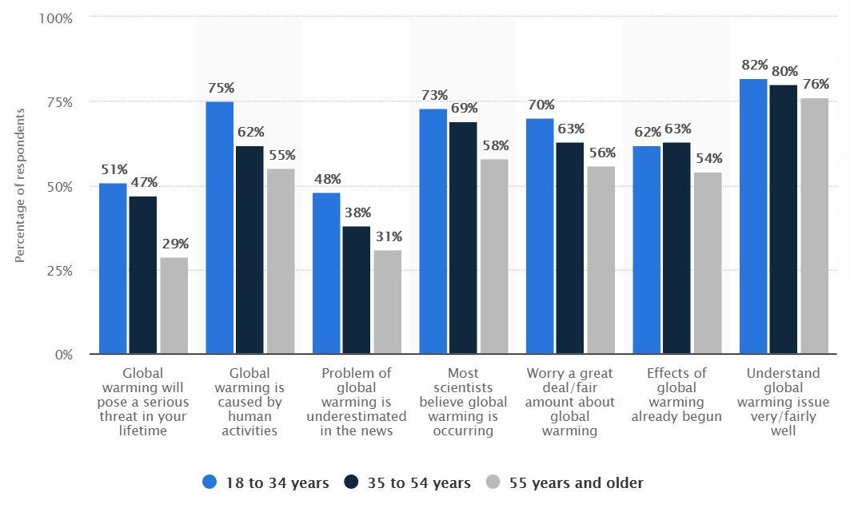
Introduction
How can products be used to promote a more sustainable lifestyle?
Needs for the end user: The users (or audience) could be potentially anyone. So I ask the question “who should the product target?” To answer this there is a need to divide the users into user groups and research each of them. Prior to research, I have divided the user groups arbitrarily as shown:
0-6
7-11
12-18
19-24
25-54
55+
I have not considered gender as to be a significant aspect. (even though there were evidence of women making more sustainable decisions, I cold not find any evidence that supported how gender could affect the awareness of climate emergency.) Therefore, my product would be gender neutral.
After research I removed some from the list or merged several into one.
According to Stanford Childrens (https://www.stanfordchildrens.org/en/topic/default?id=cognitive-development-90-P01594) children at the age of 12 start to think deeply, develop their own view of the world, question authorities and society’s standards and have increased thoughts about global concepts. This would be important as awareness of Age 0-6 are too young for “global” scale. For 7-11 year olds, Campaign Against Climate Change (https://www.campaigncc.org/schoolresources) suggests they should be aware of climate awareness followed by a survey results: “68% are interested in learning more about the environment” and “4% of students feel that they know a lot about climate change”. Therefore, I excluded the age of 0-6 and merged 7-18 as a ‘students’ user group.
As shown in the graph from Statistica, from the age of 18-34 people are well aware of global warming(it is based on the assumption that the awareness of global warming would be similar to the awareness of climate emergency) compared to the other age groups. However, the age groups of 55 years and older had a significant lack of awareness in terms of how it would be a threat in your lifetime despite the fact that climate emergency has already been declared all around the globe and is a serious issue. Ages of 18-34 would be removed from the list as I find their level of knowledge fine at the moment.
I now have a shortlist of the target user groups:
Students (mostly age 12)
Adults 35+ ( focusing on age 55)
As I am more closer to students, and as I am a student beforehand, I decided that it would be much easier to draw outcomes from the former than the latter.
In conclusion, I have chose to make a product that will increase awareness of climate emergency to students, especially 12 year olds.
To effectively establish the problem, there is a need to obtain more information about the demographics. The information I would need is:
What lifestyles are they having at the moment?
How is the

Slide 9
Introduction
How can products be used to promote a more sustainable lifestyle?
Needs for the end user: The users (or audience) could be potentially anyone. So I ask the question “who should the product target?” To answer this there is a need to divide the users into user groups and research each of them. Prior to research, I have divided the user groups arbitrarily as shown:
0-6
7-11
12-18
19-24
25-54
55+
I have not considered gender as to be a significant aspect. (even though there were evidence of women making more sustainable decisions, I cold not find any evidence that supported how gender could affect the awareness of climate emergency.) Therefore, my product would be gender neutral.
After research I removed some from the list or merged several into one.
According to Stanford Childrens (https://www.stanfordchildrens.org/en/topic/default?id=cognitive-development-90-P01594) children at the age of 12 start to think deeply, develop their own view of the world, question authorities and society’s standards and have increased thoughts about global concepts. This would be important as awareness of Age 0-6 are too young for “global” scale. For 7-11 year olds, Campaign Against Climate Change (https://www.campaigncc.org/schoolresources) suggests they should be aware of climate awareness followed by a survey results: “68% are interested in learning more about the environment” and “4% of students feel that they know a lot about climate change”. Therefore, I excluded the age of 0-6 and merged 7-18 as a ‘students’ user group.
As shown in the graph from Statistica, from the age of 18-34 people are well aware of global warming(it is based on the assumption that the awareness of global warming would be similar to the awareness of climate emergency) compared to the other age groups. However, the age groups of 55 years and older had a significant lack of awareness in terms of how it would be a threat in your lifetime despite the fact that climate emergency has already been declared all around the globe and is a serious issue. Ages of 18-34 would be removed from the list as I find their level of knowledge fine at the moment.
I now have a shortlist of the target user groups:
Students (mostly age 12)
Adults 35+ ( focusing on age 55)
As I am more closer to students, and as I am a student beforehand, I decided that it would be much easier to draw outcomes from the former than the latter.
In conclusion, I have chose to make a product that will increase awareness of climate emergency to students, especially 12 year olds.
To effectively establish the problem, there is a need to obtain more information about the demographics. The information I would need is:
What lifestyles are they having at the moment?
How is the

Slide 10
The User

Slide 11
Investigation

Slide 12
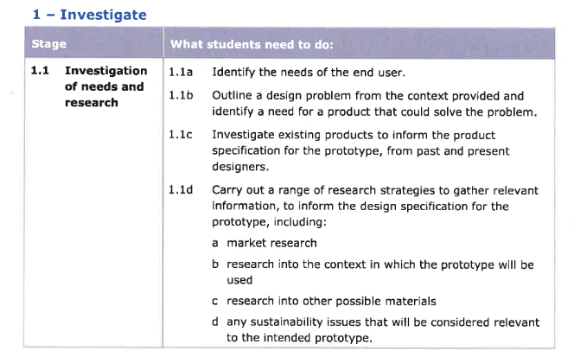
Spec
Needs of users
Research users
Outline design (FIND A NEED)
Investigate existing products
Other researches for design specification

